Slide 1
980HX-887904-KAG-A10
Supplementary Explanation
2026/11/6

Slide 2
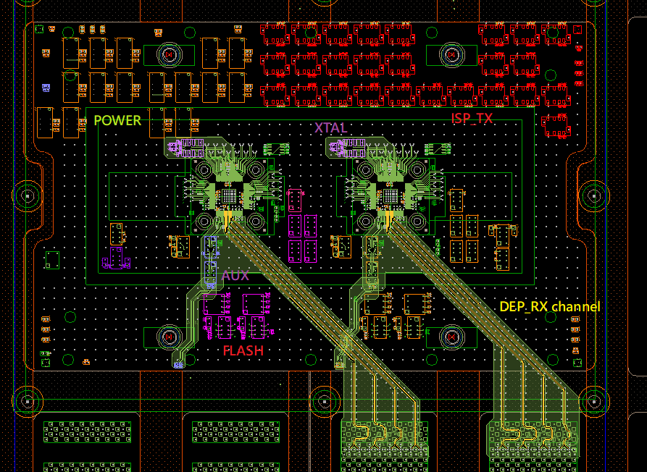
Supplementary Explanation 1
ISP_TX Relay needs to be close to BASE, no COPY SITE required
**EDP_RX:** Route from TOP to PS9G, following the GND VIA all the way to CHANNEL.
**Requires GND SHIELDING.**

Slide 3
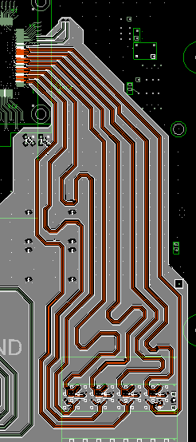
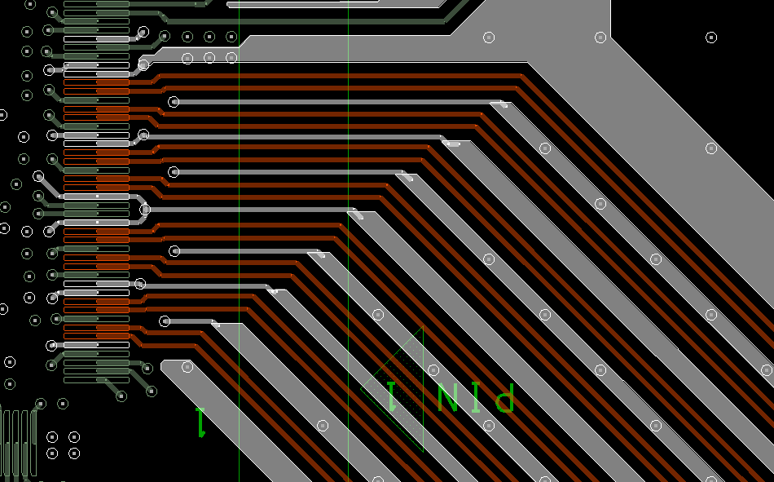
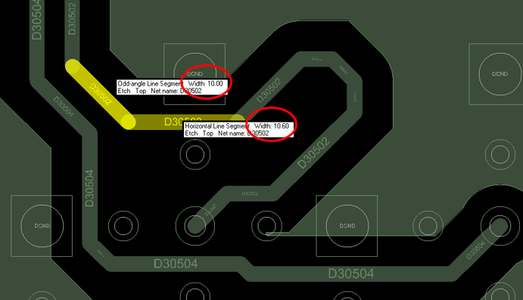
Notice
**EDP_RX:** Route from TOP to PS9G, following the GND VIA all the way to CHANNEL.
**Requires GND SHIELDING.**
** Differential pairs require a 50-ohm trace width after splitting/branching.
Dut to relay route L28/L30/L32
Relay to PS1600 route L3/L5/L7

Slide 4
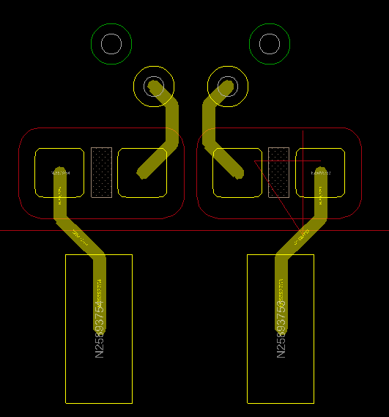
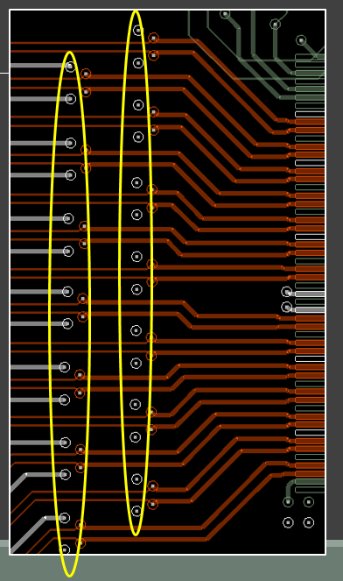
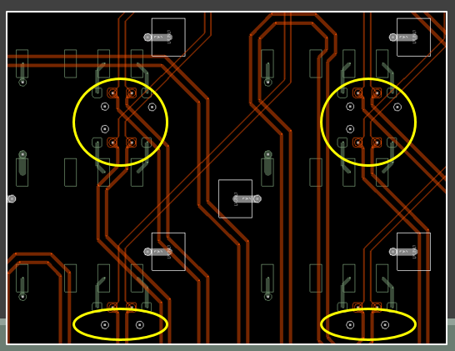
Notice
**ISP_TX:**
Fill with via after TOP FAN OUT, requiring guard holes.
The TUNE cable is located between the DUT and the RELAY.
Route to PS9G
Overall General Routing:
  DUT to RELAY: All signal lines from the DUT must be connected to either L32 or L30 on the RELAY side.
  RELAY to ATE: All signal lines to the ATE must be connected from either L3 or L5 on the RELAY side.
Signal Pairing Rules per RELAY (Do NOT cross-connect):
  Path 1 : Route from the DUT to RELAY L32, and then route from L3 of the same RELAY to the ATE.
  Path 2 : Route from the DUT to RELAY L30, and then route from L5 of the same RELAY to the ATE.
• Channel Planning Priority: RX → TX → Other
• Basic Routing Principles: For RX/TX, the shortest trace length must be the highest priority.

Slide 5
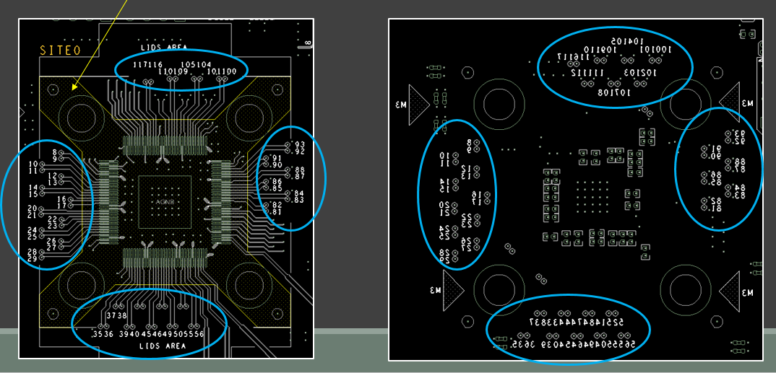
Notice
LVDS and Mini-LVDS layer transition vias must be circled and labeled with their Pin numbers. If a transition via is located within the solder mask (yellow) area, it can be ignored.
SILK_Top
SILK_BOT

Slide 6
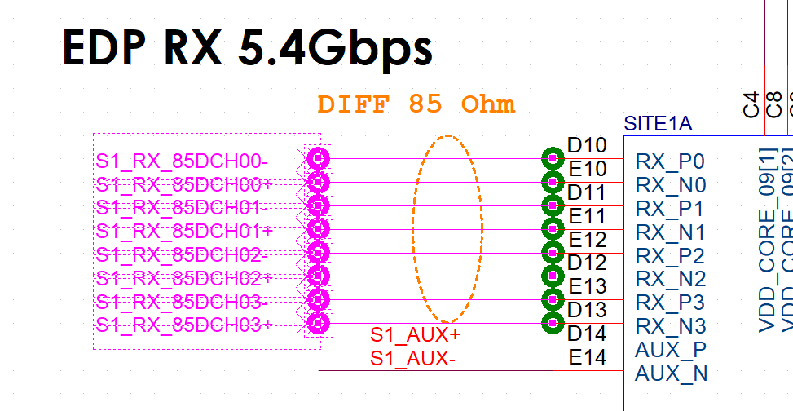
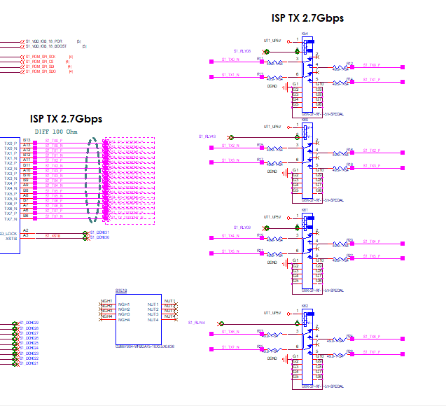
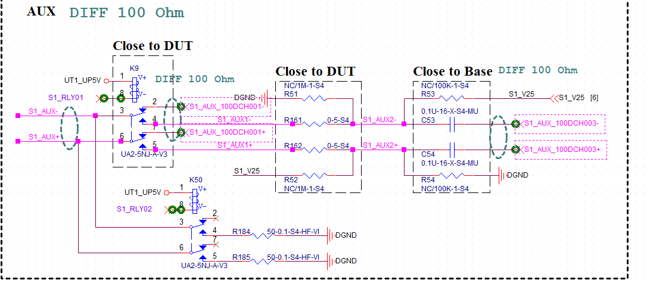
Simulation_Items
1. eDP RX
3. ISP_TX
1. AUX

Slide 7
Simulation_Items
4. PI
1 | S1_VDDIO_18
2 | S1_VDD09_CORE
3 | S1_VDD_TXPST_09
4 | S1_VDD_TX_09_HDO
5 | S1_VDDRX_AUX_09
6 | S1_VDD_IOB_18_BOOST
7 | S1_VDD_PLL_09
8 | S1_VDDRX_09
9 | S1_VDD_TX_09
10 | S1_VDD_IOB_18_POR
Item | Plan
Net-in (Start layout) | 2026.11.9
PCB placement provide | 2026/11/11
RX(9G)Simulation placement provide | 2026/11/17
ISP_TX /AUX Simulation placement provide | 2026/11/23
PI Simulation placement provide | 2026/11/26
PCB layout Final provide | 2026/12/7
PCB Silkscreen Final provide | 2026/12/8

Slide 8
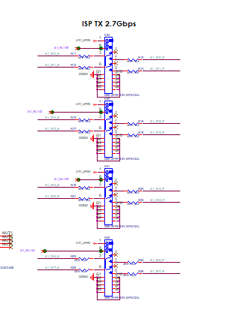
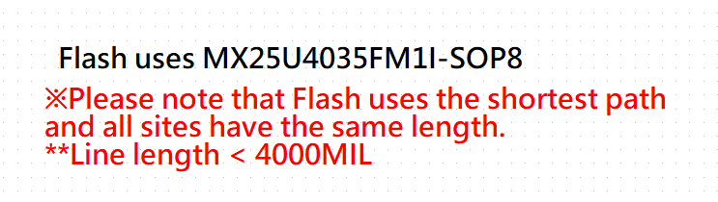
PLACEMENT NOTICE
The TX RELAY must be placed close to the ATE and no copy site required.
1. DUT Proximity Priority Order:
FLASH ➔ I2C ➔ AUX ➔ RST = TEST
(Note: Components must be placed as close to the DUT as possible following this sequence.)
2. POWER RELAY Placement:
The POWER RELAY only needs to be placed along the assigned path.

Slide 9
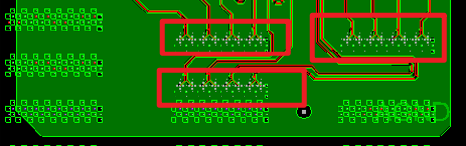
ASSIGN NOTICE
Please ensure that EDP_RX and ISP_TX are configured within the same slot and on the same site.
RX、TX needs Assign to PS9G SLOT
It is strictly forbidden to use channels from different sites within a single slot.
To prevent any routing issues for RX, please assign it to the front-row channels of the PS9G SLOT. It is strictly forbidden to route backwards to connect to the channels ，CHECK The image below
Additionally, the AUX circuit channels must utilize the shortest path; therefore, the assigned slots must use the front-row channels.

